Slide 1

ITSF Keynote
5G – Operator Perspective
6 November 2018

Slide 2
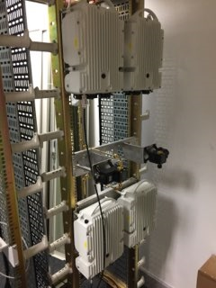
Content
EE/BT – where are we with 5G
5G – what is it about & what is it really about
Architecture
Standards
EN-DC
What does this mean for day 1
Where do we go for day 2
Operator issues that need to be addressed
Summary

Slide 3

EE/BT – where are we with 5G
BT (British Telecom) purchased EE from DT/Orange 3 years ago
    Successful 4G network
    Top of Rootmetrics surveys in UK
    Up to 1Gbps download to handset
    Carrier aggregation and 10GE backhaul
    Re-farm of 2G and now 3G spectrum for LTE
    Core network sourced frequency sync for FDD
  5G trial with friendly users Nov 18 with launch 2019

Slide 4


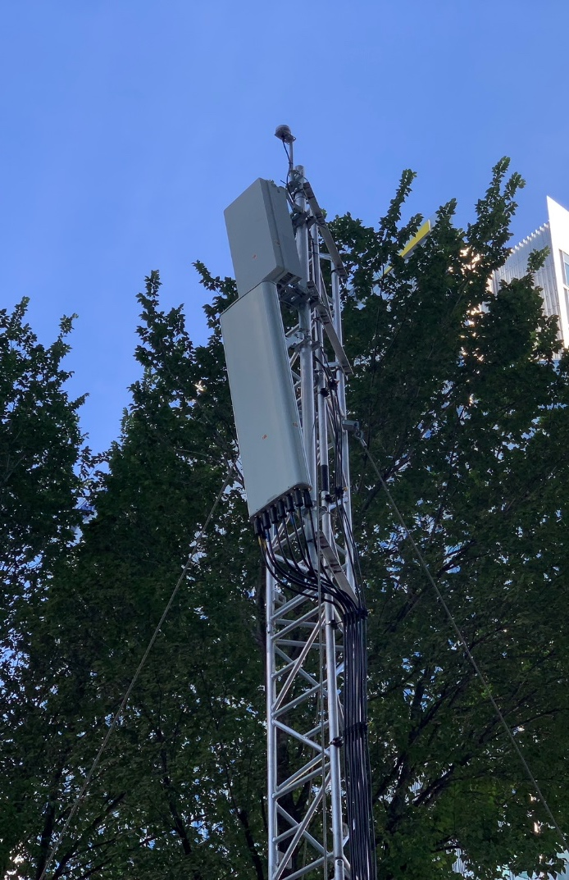
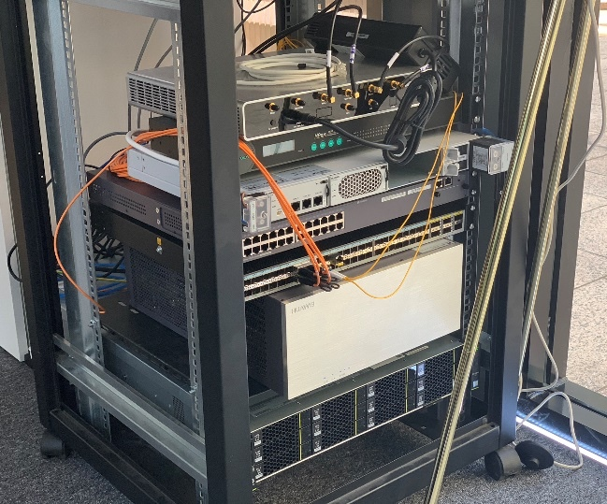
5G demo at Canary Wharf
Highlights
1.3Gbps to test equipment (30 MHz LTE + 40 MHz NR)
600Mbps to Huawei 5G CPE (5 MHz LTE + 40 MHz NR)
4T4R LTE (15 MHz 2100 + 15 MHz 2600) with 64T64R NR

Slide 5

5G - what is it all about - IMT2020
5G goals
    Higher peak and average data rates
      Peak 20Gbps down (10Gbps up), average user experience of 100Mbps (50Mbps up)
    Massive traffic density
      nx10k users per stadium at 10s Mbps each
      nx10 users per office floor at 1Gbps each
    Massive connectivity (mMTC)
      1M connections per square km

Slide 6
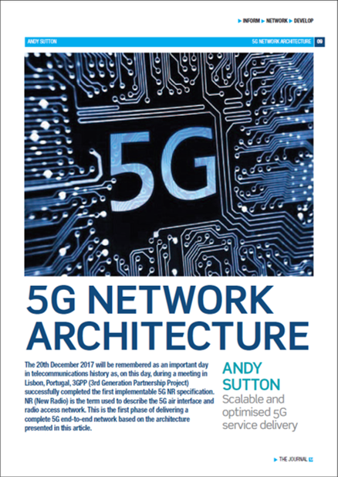
5G - what is all about
5G goals
Ultra-low latency
        0.5ms for URLLC, 4ms for eMBB (one way) (3GPP radio)
Ultra reliable network
        Available at all times, in all places
Spectrum efficiency
        Minimum downlink peak 30bit/s/Hz
        A step change from LTE today

Slide 7
5G - what is really about
Perception of infinite capacity and always connected!

Slide 8
Use case mapping to capabilities
High peak and average speeds
Enhanced MBB
3D / UHD Video
Cloud working
Augmented reality
Industrial automation
Smart home
Connected and Autonomous Vehicles
MTC IoT
Smart city
Mission Critical
Massive connectivity
Low Latency High Reliability

Slide 9
5G NR (New Radio) – new base station architecture
LTE
Single Node with Radio Unit and Baseband Unit, or Remote Radio Unit using CPRI up a mast
5G New Radio
Radio and Baseband effectively split into a Distributed Unit and a Central Unit, but what protocol runs between them. It also now has a name - F1 interface & F2 for DU to Radio Unit/Active Antenna Unit.
Backhaul
CPRI
Backhaul
RRU/BBU
RRU
BBU
?
Backhaul
?
?
Backhaul
DU
CU
AAU
DU
CU
F1
F2
F1

Slide 10
5G New Radio Architecture
Functional Splits
F1 - Option 2 - High Level Split - similar to LTE backhaul – little change with 3µs relative
  Current LTE macro network of sites and backhaul makes a good starting point for 5G
F2 - Option 7 – Low level Split - eCPRI
  Relative TAE becomes more important, especially with more interference and more beamforming with AAUs
  Also as Ethernet based CPRI, this means we need Ethernet type sync technology – ie PTP, etc

Slide 11
5G New Radio Architecture
Beamforming
MIMO
Option 7
Antenna
AAU
DU
Option 2
CU
Option 2
Antenna
3µs
Interference
Antenna
DU
3µs
Antenna
DU
3 µs
Antenna
DU

Slide 12
Standards
ITU - GSTR-TN5G - Transport network support of IMT-2020/5G
ETSI TS 138 133 V15.2.0 (2018-07) - Requirements for support of radio resource management
  7.4 Cell phase synchronisation accuracy
      7.4.1 Definition
        Cell phase synchronisation accuracy for TDD is defined as the maximum absolute deviation in frame start timing between any pair of cells on the same frequency that have overlapping coverage areas.
      7.4.2 Minimum requirements
        The cell phase synchronisation accuracy measured at BS antenna connectors shall be better than 3 µs.

Slide 13
Standards
In many ways we are probably already there, as +/- 1.5µs absolute for standard TDD networks.
The standards also talk about tighter requirements for timing – this is likely to be at the local level between AAU and DUs possibly, and as it is a much more local situation, then this can probably be achieved with PTP with very few hops but full timing support of all nodes in the network. (sub 100 ns) – to be investigated further.

Slide 14
EN-DC
    EN-DC - E-UTRA-NR Dual Connectivity
    This is Option 3x - 4G with a 5G gNB attached - connecting to the LTE EPC+.
    5G is primarily a user plane enhancement for eMBB

Slide 15
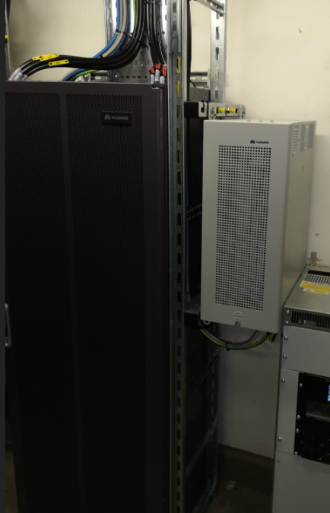
What does this mean Day 1
Day 1
    Option 3x -a dual deployment of gNB and eNB – gNB has no control plane and is dependant on X2 to eNB to the EPC+ on S1
    UE can download on one node and upload on the other, or traffic can be balanced over both bearers.
    Sync requirements of +/- 1.5µs absolute to support TDD
    Hybrid sync is the preferred option – loss of pure PTP will lock down TDD radio

Slide 16

What does this mean Day 2
Day 2
    Option 7/2/4 – 5G Core
    CU/DU – RAN Functional Decomposition
    5G Stand alone radio
    NFV – Network Function Virtualisation – CU/IPSec GW/UPF/Content Distribution
    IPV6 - infrastructure
    RU/AAU/Small Cells
      tighter relative sync between local nodes
      Network Based MIMO

Slide 17
Operator issues that need to be addressed
    GPS – is it fit for purpose and where does it fit an operators plans
    Hybrid sync – essential to maintain phase if PTP is lost – TDD radio shut down
    No guard band - inter operator interference. UK issue – operators will need to work together. UK awaiting OFCOM guidance or operator agreement. In China it is mandated.
    AAU and tighter local sync requirements.
    Day 1 - build the likely services - ie. eMBB
    Day 2 - evolution – the rest of the triangle – apparently it has 3 corners (not 1)

Slide 18
Operator issues that need to be addressed
    5G is here, but it is not standalone – it uses EN-DC – Option 3x
    The TDD radio has a known requirement of 3µs relative sync
    Network Based MIMO may be the driver for tighter requirements.

